Slide 1


Feedforward and Feedback networks
=============================================================================
WWW.THEMLLABS.COM || contact@themllabs.com || Phone : 91-7338339898, 91-6362546088

Slide 2


Agenda
Introduction to Feedforward
Single-layer perceptron
Multi-layer perceptron
Other feedforward networks
=============================================================================
WWW.THEMLLABS.COM || contact@themllabs.com || Phone : 91-7338339898, 91-6362546088

Slide 3
Introduction to Feedforward neural network
A feedforward neural network is an artificial neural network wherein connections between the nodes do not form a cycle. As such, it is different from its descendant: recurrent neural networks.
The feedforward neural network was the first and simplest type of artificial neural network devised. In this network, the information moves in only one direction forward from the input nodes, through the hidden nodes (if any) and to the output nodes. There are no cycles or loops in the network.
=============================================================================
WWW.THEMLLABS.COM || contact@themllabs.com || Phone : 91-7338339898, 91-6362546088

Slide 4
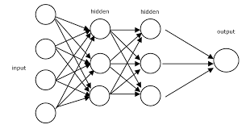
Single-layer perceptron
Multi-layer perceptron
=============================================================================
WWW.THEMLLABS.COM || contact@themllabs.com || Phone : 91-7338339898, 91-6362546088

Slide 5
Single-layer perceptron
The simplest kind of neural network is a single-layer perceptron network, which consists of a single layer of output nodes.
The inputs are fed directly to the outputs via a series of weights. The sum of the products of the weights and the inputs is calculated in each node, and if the value is above some threshold (typically 0) the neuron fires and takes the activated value (typically 1) otherwise it takes the deactivated value (typically -1).
=============================================================================
WWW.THEMLLABS.COM || contact@themllabs.com || Phone : 91-7338339898, 91-6362546088

Slide 6
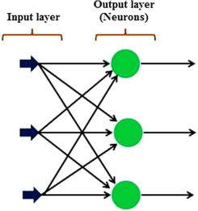
Layer is formed by taking processing elements and combining it with other processing elements. Input are connected to the processing nodes with various weights, resulting in series of outputs one per node.
Neurons with this kind of activation function are also called artificial neurons or linear threshold units. In the literature the term perceptron often refers to networks consisting of just one of these units.
=============================================================================
WWW.THEMLLABS.COM || contact@themllabs.com || Phone : 91-7338339898, 91-6362546088

Slide 7
A perceptron can be created using any values for the activated and deactivated states as long as the threshold value lies between the two.
Perceptron's can be trained by a simple learning algorithm that is usually called the delta rule.
It calculates the errors between calculated output and sample output data, and uses this to create an adjustment to the weights, thus implementing a form of gradient descent.
=============================================================================
WWW.THEMLLABS.COM || contact@themllabs.com || Phone : 91-7338339898, 91-6362546088

Slide 8
Single-layer perceptron's are only capable of learning linearly separable patterns.
single-layer perceptron network to learn an XOR function.
Although a single threshold unit is quite limited in its computational power, it has been shown that networks of parallel threshold units can approximate any continuous function from a compact interval of the real numbers into the interval [-1,1].
=============================================================================
WWW.THEMLLABS.COM || contact@themllabs.com || Phone : 91-7338339898, 91-6362546088

Slide 9
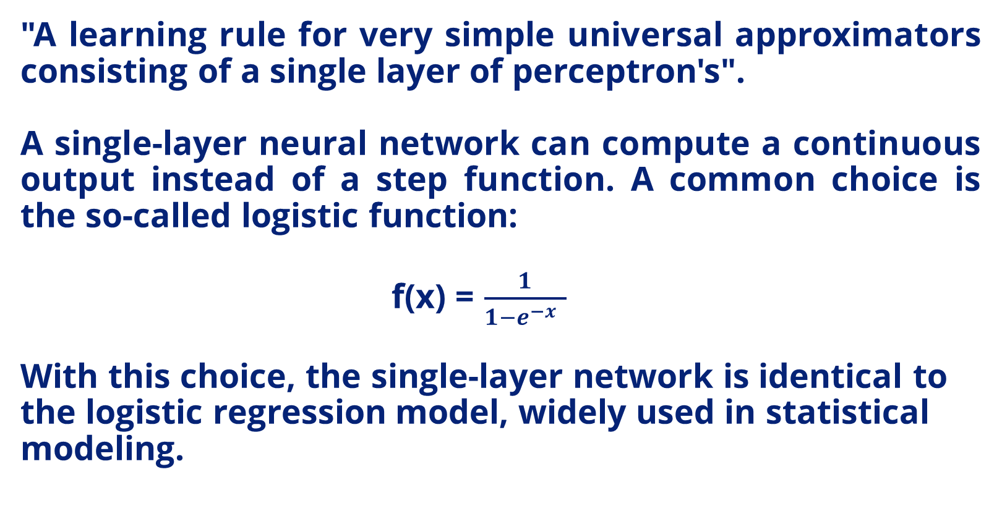
=============================================================================
WWW.THEMLLABS.COM || contact@themllabs.com || Phone : 91-7338339898, 91-6362546088

Slide 10
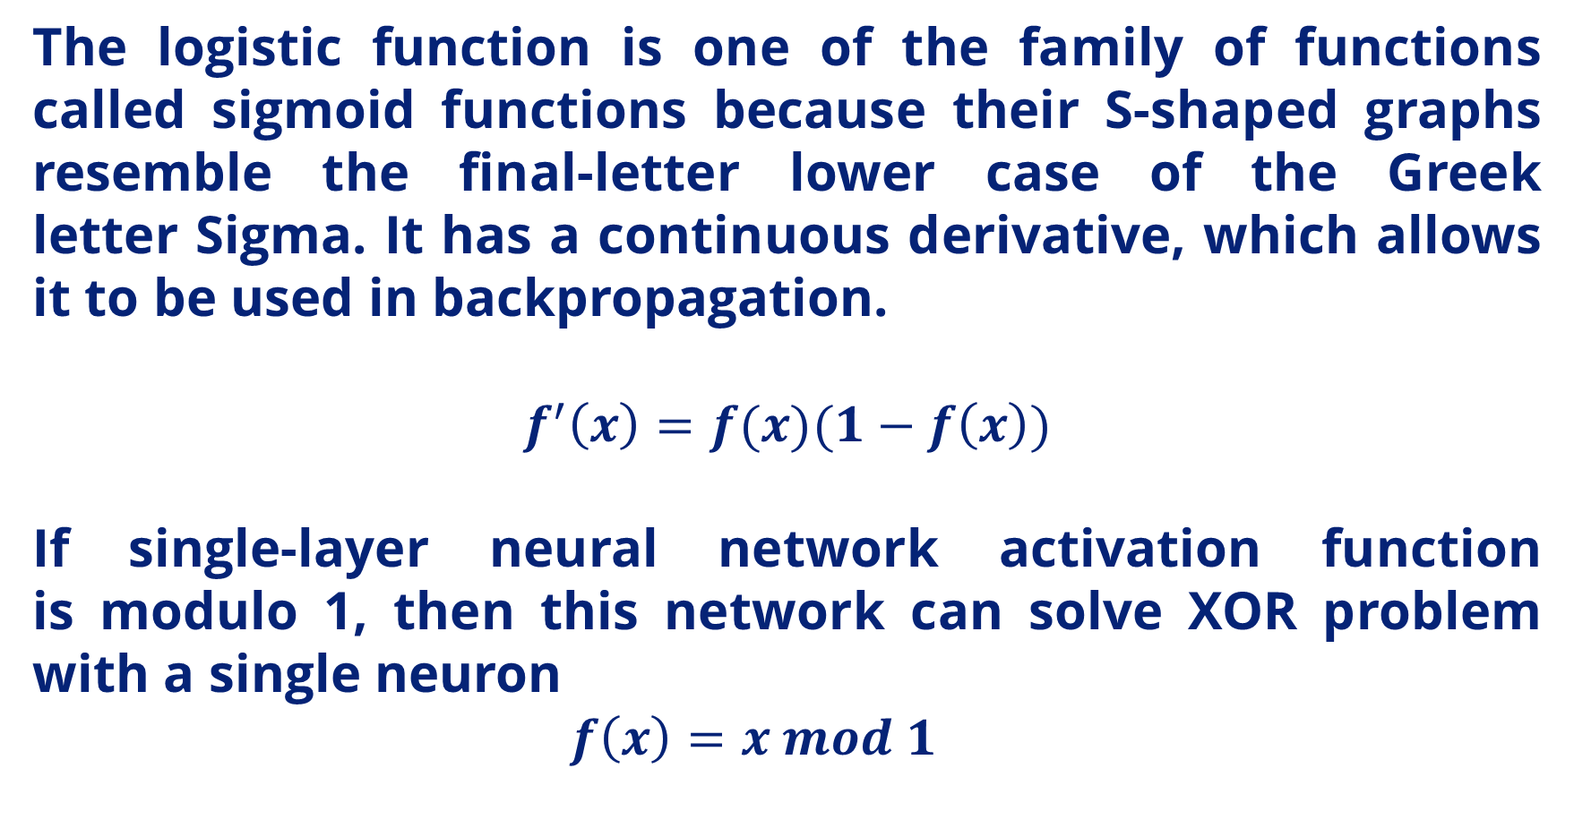
=============================================================================
WWW.THEMLLABS.COM || contact@themllabs.com || Phone : 91-7338339898, 91-6362546088

Slide 11
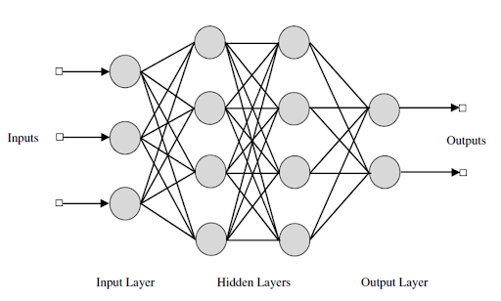
Multi-layer perceptron
=============================================================================
WWW.THEMLLABS.COM || contact@themllabs.com || Phone : 91-7338339898, 91-6362546088

Slide 12
Multi-layer perceptron
The universal approximation theorem for neural networks states that every continuous function that maps intervals of real numbers to some output interval of real numbers can be approximated arbitrarily closely by a multi-layer perceptron with just one hidden layer.
This result holds for a wide range of activation functions, e.g. for the sigmoidal functions.
=============================================================================
WWW.THEMLLABS.COM || contact@themllabs.com || Phone : 91-7338339898, 91-6362546088

Slide 13
Multi-layer networks use a variety of learning techniques, the most popular being back-propagation. The output values are compared with the correct answer to compute the value of some predefined error-function.
By various techniques, the error is then fed back through the network
Using this information, the algorithm adjusts the weights of each connection in order to reduce the value of the error function by some small amount.
=============================================================================
WWW.THEMLLABS.COM || contact@themllabs.com || Phone : 91-7338339898, 91-6362546088

Slide 14
After repeating this process for a sufficiently large number of training cycles, the network will usually converge to some state where the error of the calculations is small.
To adjust weights properly, one applies a general method for non-linear optimization that is called gradient descent.
For this, the network calculates the derivative of the error function with respect to the network weights, and changes the weights such that the error decreases.
=============================================================================
WWW.THEMLLABS.COM || contact@themllabs.com || Phone : 91-7338339898, 91-6362546088

Slide 15
For this reason, back-propagation can only be applied on networks with differentiable activation functions.
The problem of teaching a network to perform well, even on samples that were not used as training samples, is a quite subtle issue that requires additional techniques.
This is especially important for cases where only very limited numbers of training samples are available.
The danger is that the network overfits the training data and fails to capture the true statistical process generating the data.
=============================================================================
WWW.THEMLLABS.COM || contact@themllabs.com || Phone : 91-7338339898, 91-6362546088

Slide 16
Computational learning theory is concerned with training classifiers on a limited amount of data.
The context of neural networks a simple heuristic, called early stopping, often ensures that the network will generalize well to examples not in the training set.
Other typical problems of the back-propagation algorithm are the speed of convergence and the possibility of ending up in a local minimum of the error function.
=============================================================================
WWW.THEMLLABS.COM || contact@themllabs.com || Phone : 91-7338339898, 91-6362546088

Slide 17
There are practical methods that make back-propagation in multi-layer perceptron's the tool of choice for many machine learning tasks.
One also can use a series of independent neural networks moderated by some intermediary, a similar behavior that happens in brain.
These neurons can perform separably and handle a large task, and the results can be finally combined.
=============================================================================
WWW.THEMLLABS.COM || contact@themllabs.com || Phone : 91-7338339898, 91-6362546088

Slide 18
Other feedforward networks
More generally, any directed acyclic graph may be used for a feedforward network, with some nodes (with no parents) designated as inputs, and some nodes (with no children) designated as outputs.
These can be viewed as multilayer networks where some edges skip layers, either counting layers backwards from the outputs or forwards from the inputs. Various activation functions can be used, and there can be relations between weights, as in convolutional neural networks.
=============================================================================
WWW.THEMLLABS.COM || contact@themllabs.com || Phone : 91-7338339898, 91-6362546088

Slide 19
feedforward networks include radial basis function networks, which use a different activation function.
Sometimes multi-layer perceptron is used loosely to refer to any feedforward neural network, while in other cases it is restricted to specific ones
(e.g., with specific activation functions, or with fully connected layers, or trained by the perceptron algorithm).
=============================================================================
WWW.THEMLLABS.COM || contact@themllabs.com || Phone : 91-7338339898, 91-6362546088

Slide 20
The term backpropagation strictly refers only to the algorithm for computing the gradient The term is often used loosely to refer to the entire learning algorithm.
Backpropagation generalizes the gradient computation in the delta rule, which is the single-layer version of backpropagation, and is in turn generalized by automatic differentiation, where backpropagation is a special case of reverse accumulation
=============================================================================
WWW.THEMLLABS.COM || contact@themllabs.com || Phone : 91-7338339898, 91-6362546088

